Slide 1

Deep Learning Models: Online Host, Visualization and Deployment
Presented By:
Rahul Dhamerla,7
Teja Devarapalli,5
Gopi Chand Bodepudi,2
Vasudev Madala,16

Slide 2
Motivation
With the advances in deep learning applications, sharing the trained models online becomes a critical component of the overall deep learning lifecycle. Currently, trained models are share on private websites or dumped into storage services like GitHub, which cannot visualize the model and its metadata, test it online, or deploy it online.

Slide 3
Project Goal/Objective
Our idea was to develop a web application similar to GitHub for users to host trained models and provide access with everyone to download and can like or comment accordingly.

Slide 4
System Features
User Dashboard
Upload
Download
Search
View
Like
Delete
Comment

Slide 5
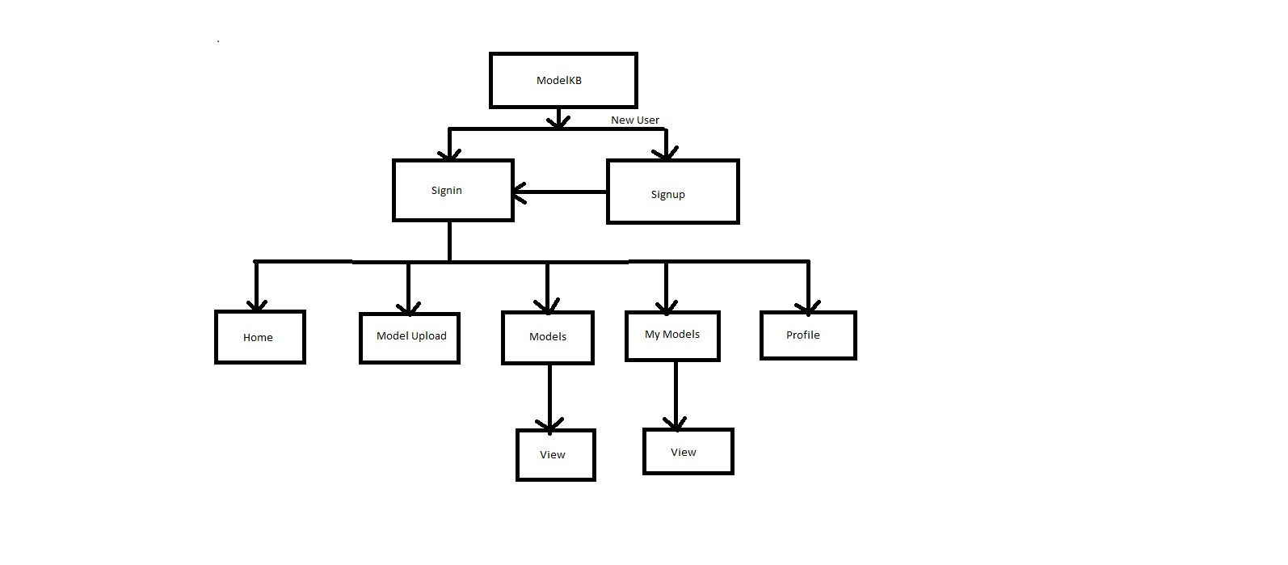
System Architecture

Slide 6
Technologies/Applications
Mongo DB
Express JS
Angular JS
Node JS
HTML5,CSS3,Bootstrap
WebStorm

Slide 7
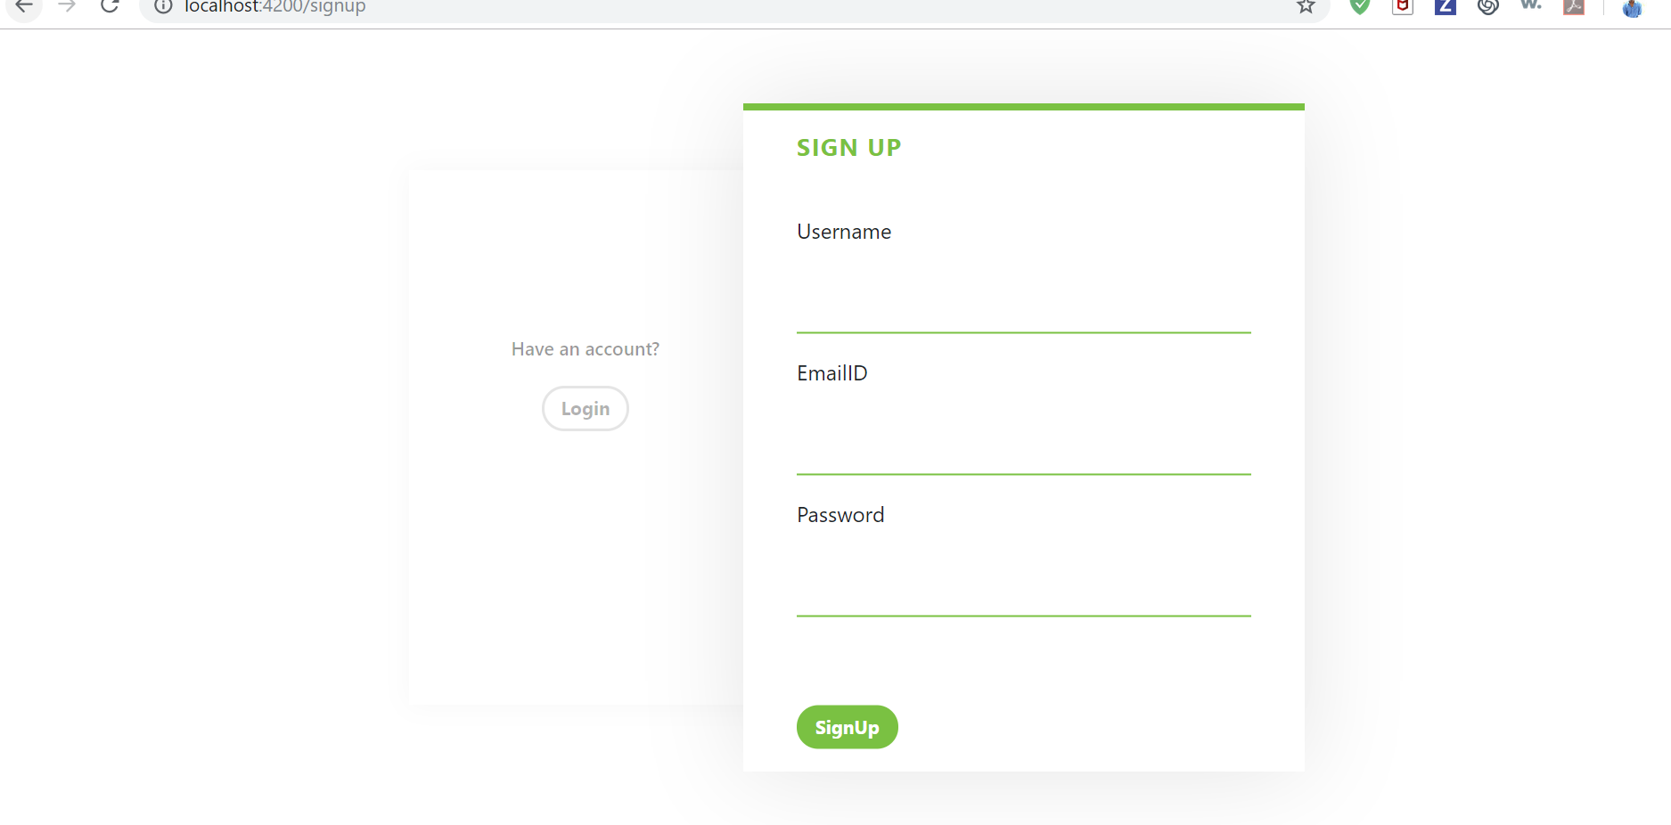
Screenshots : Sign UP

Slide 8
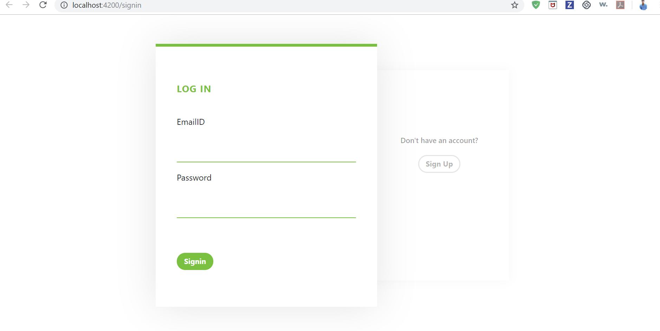
Sign IN

Slide 9
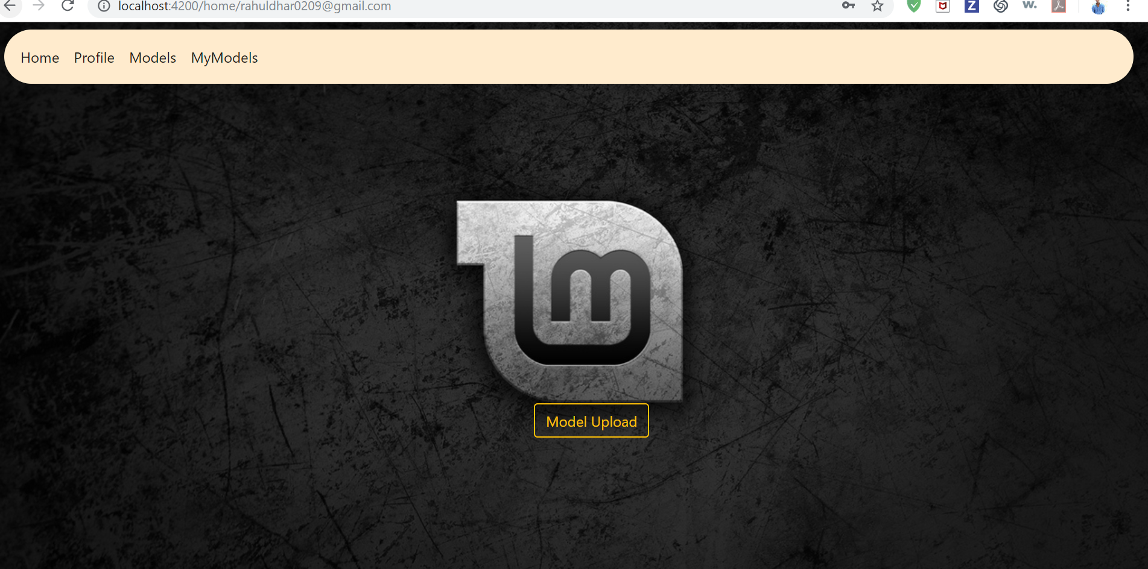
Home

Slide 10
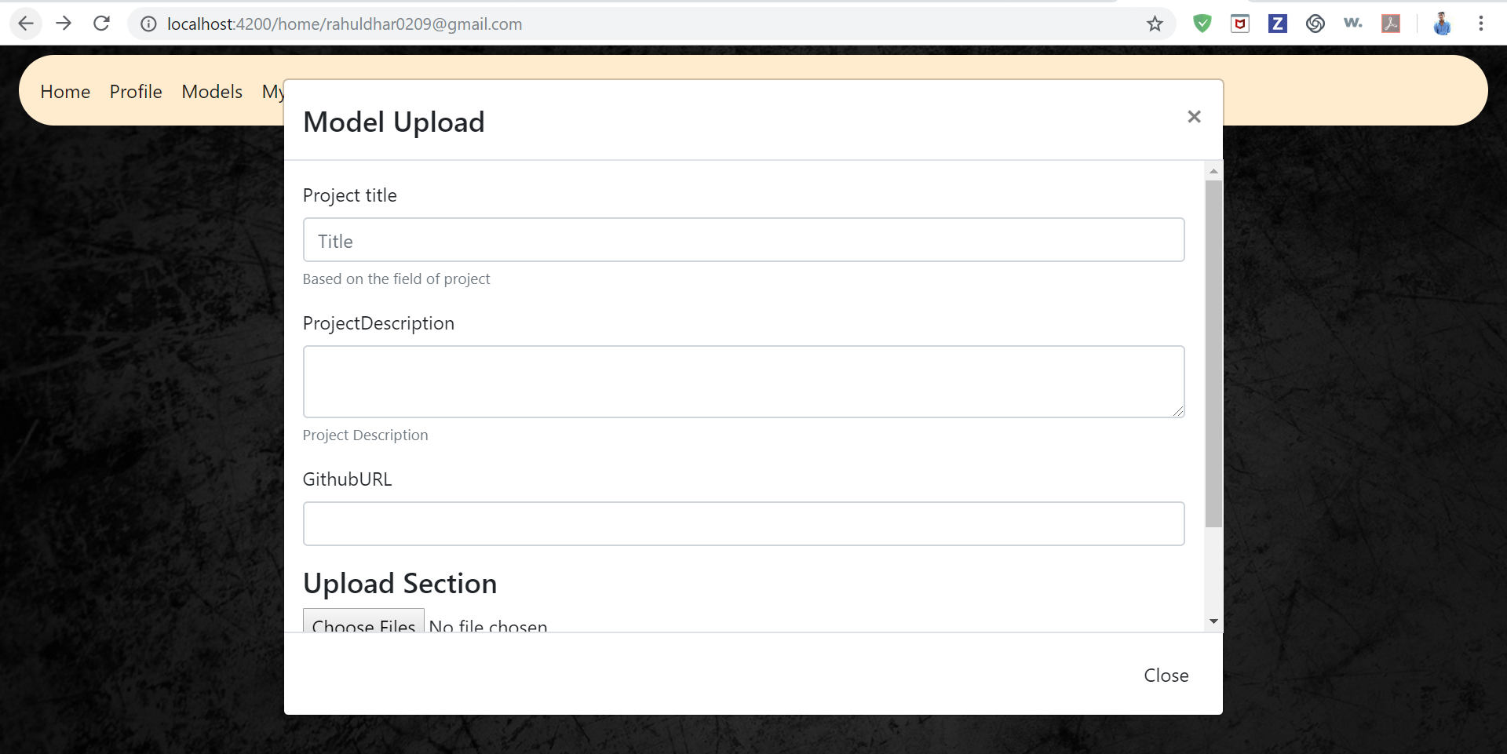
Upload

Slide 11

Profile

Slide 12
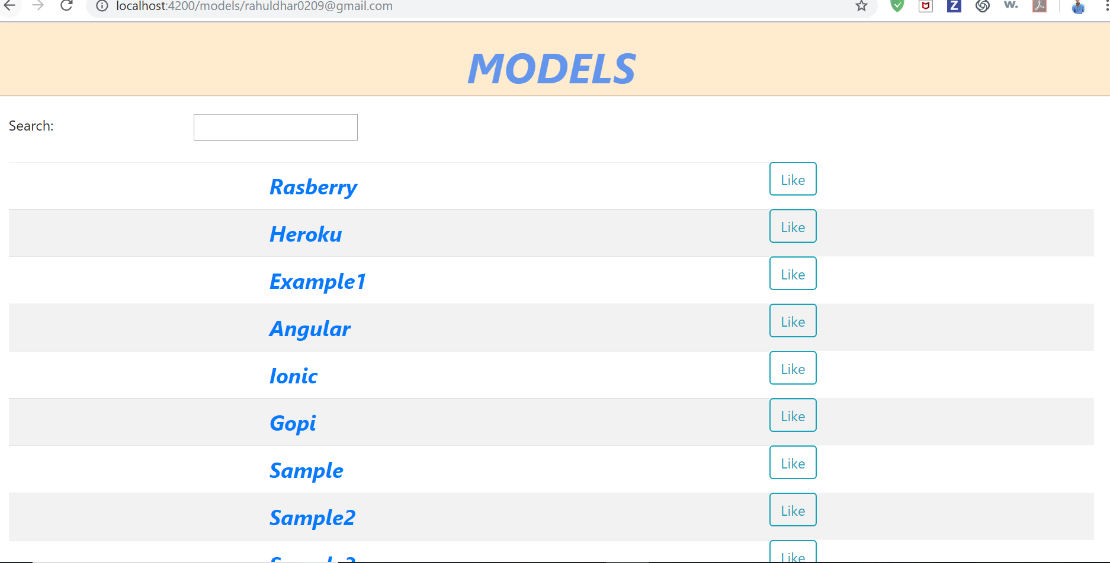
Models

Slide 13
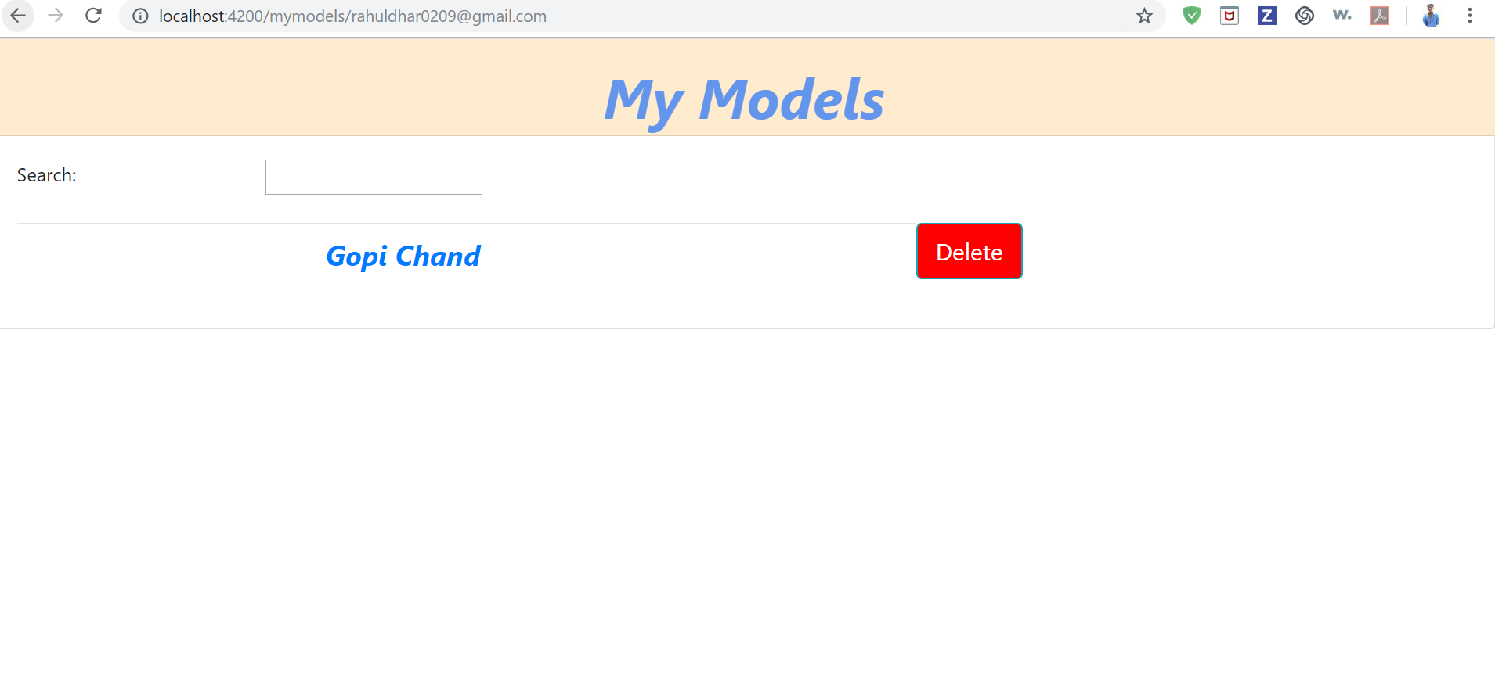
MyModels

Slide 14
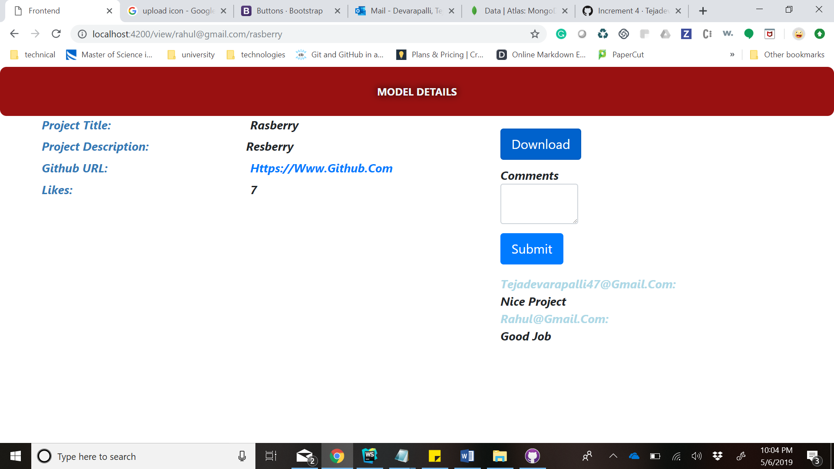
View Model

Slide 15
Testing
As part of Unit Testing ,we have tested all the functionalities of the features developed.
Manual Testing.
Regression Testing: This testing is done to make sure that new code changes should not have side effects on the existing functionalities. It ensures that the old code still works once the new code changes are done.

Slide 16
Thank you

